Slide 2
Content:
Energia RK, LLP
About us
Our solutions
Our advantages:
Clients
Partners
Licenses
Management sertificates
Our achievements:
Energia RK in figures
We are recommended
Company culture:
Mission
Values

Slide 3
About us:
Our company was established in 2006 and since then has been helping specialists in the industrial, industrial and energy sectors The Republic of Kazakhstan and the CIS countries to improve their work by providing reliable and functional solutions in the field of communications and Information Technology.

Slide 4
We are a system integrator and supplier of telecommunications equipment in the segment of industrial and energy enterprises.
We provide reliable and functional communications and information technology solutions.
We have experience in implementing modern telecommunication systems of any complexity.

Slide 5
Our solutions:
ATE with SORM function
IoT, IIoT solutions
CCTV systems
GHS and warning systems
Data transmission systems
Server solutions
Radiocommunication Solutions
Voice solutions
Wireless solutions
Video walls

Slide 6
Our clients :
and many others…

Slide 7
Our Partners:
and many others…

Slide 8
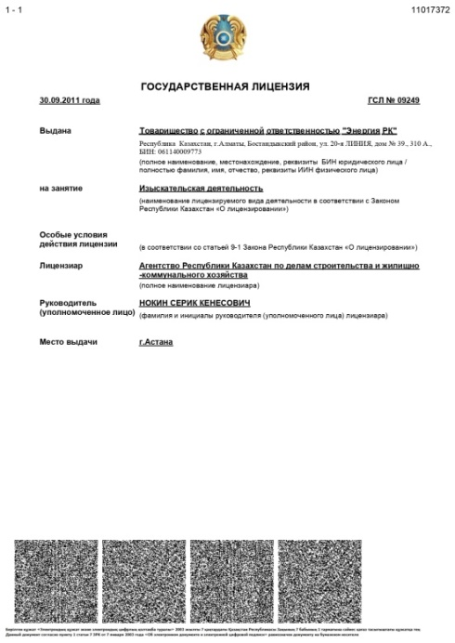
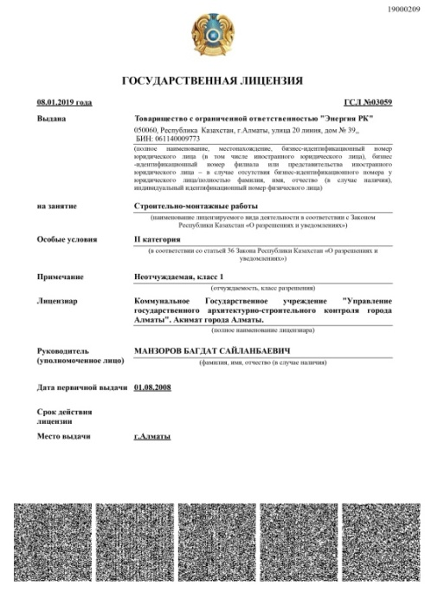
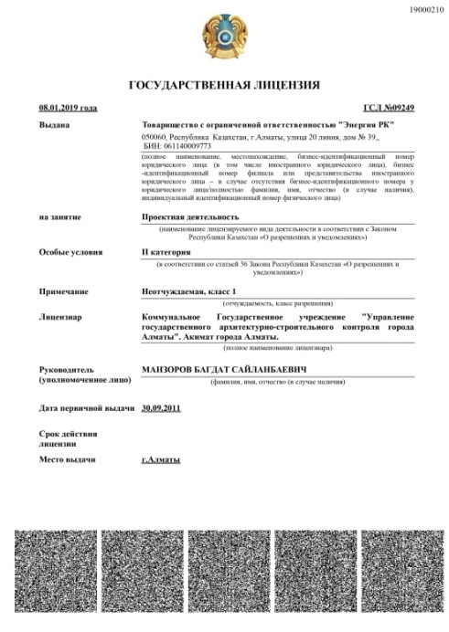
Our Licenses :
Exploration activities
Construction and installation work
Project activities

Slide 9
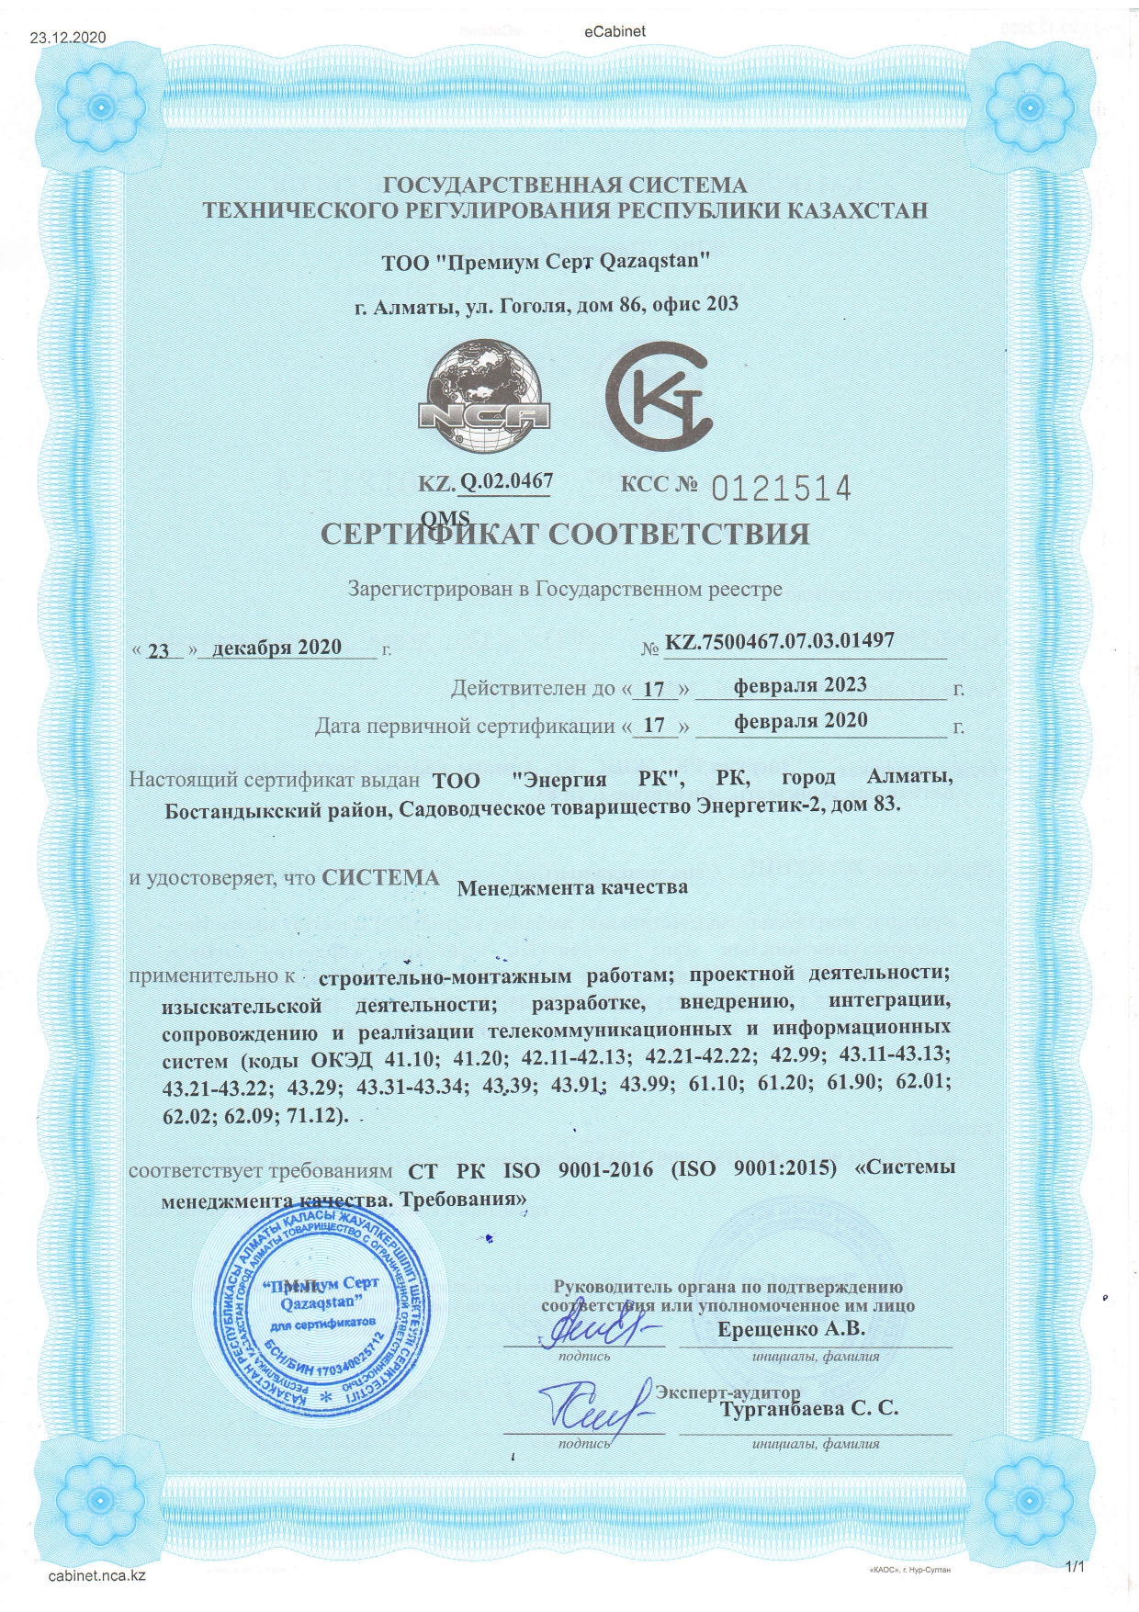
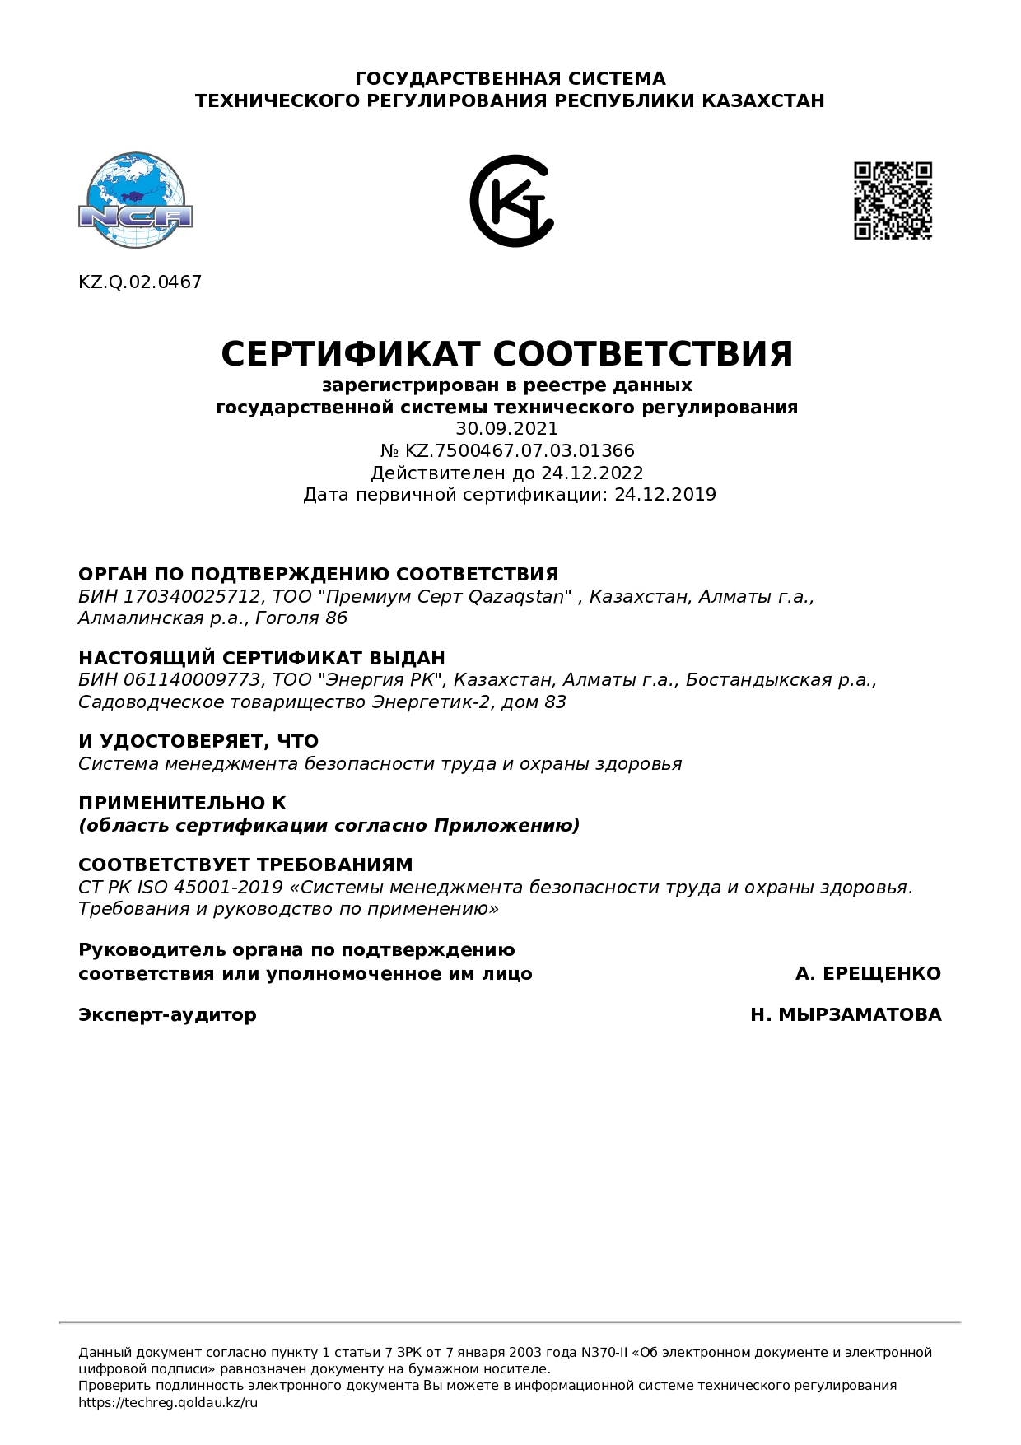
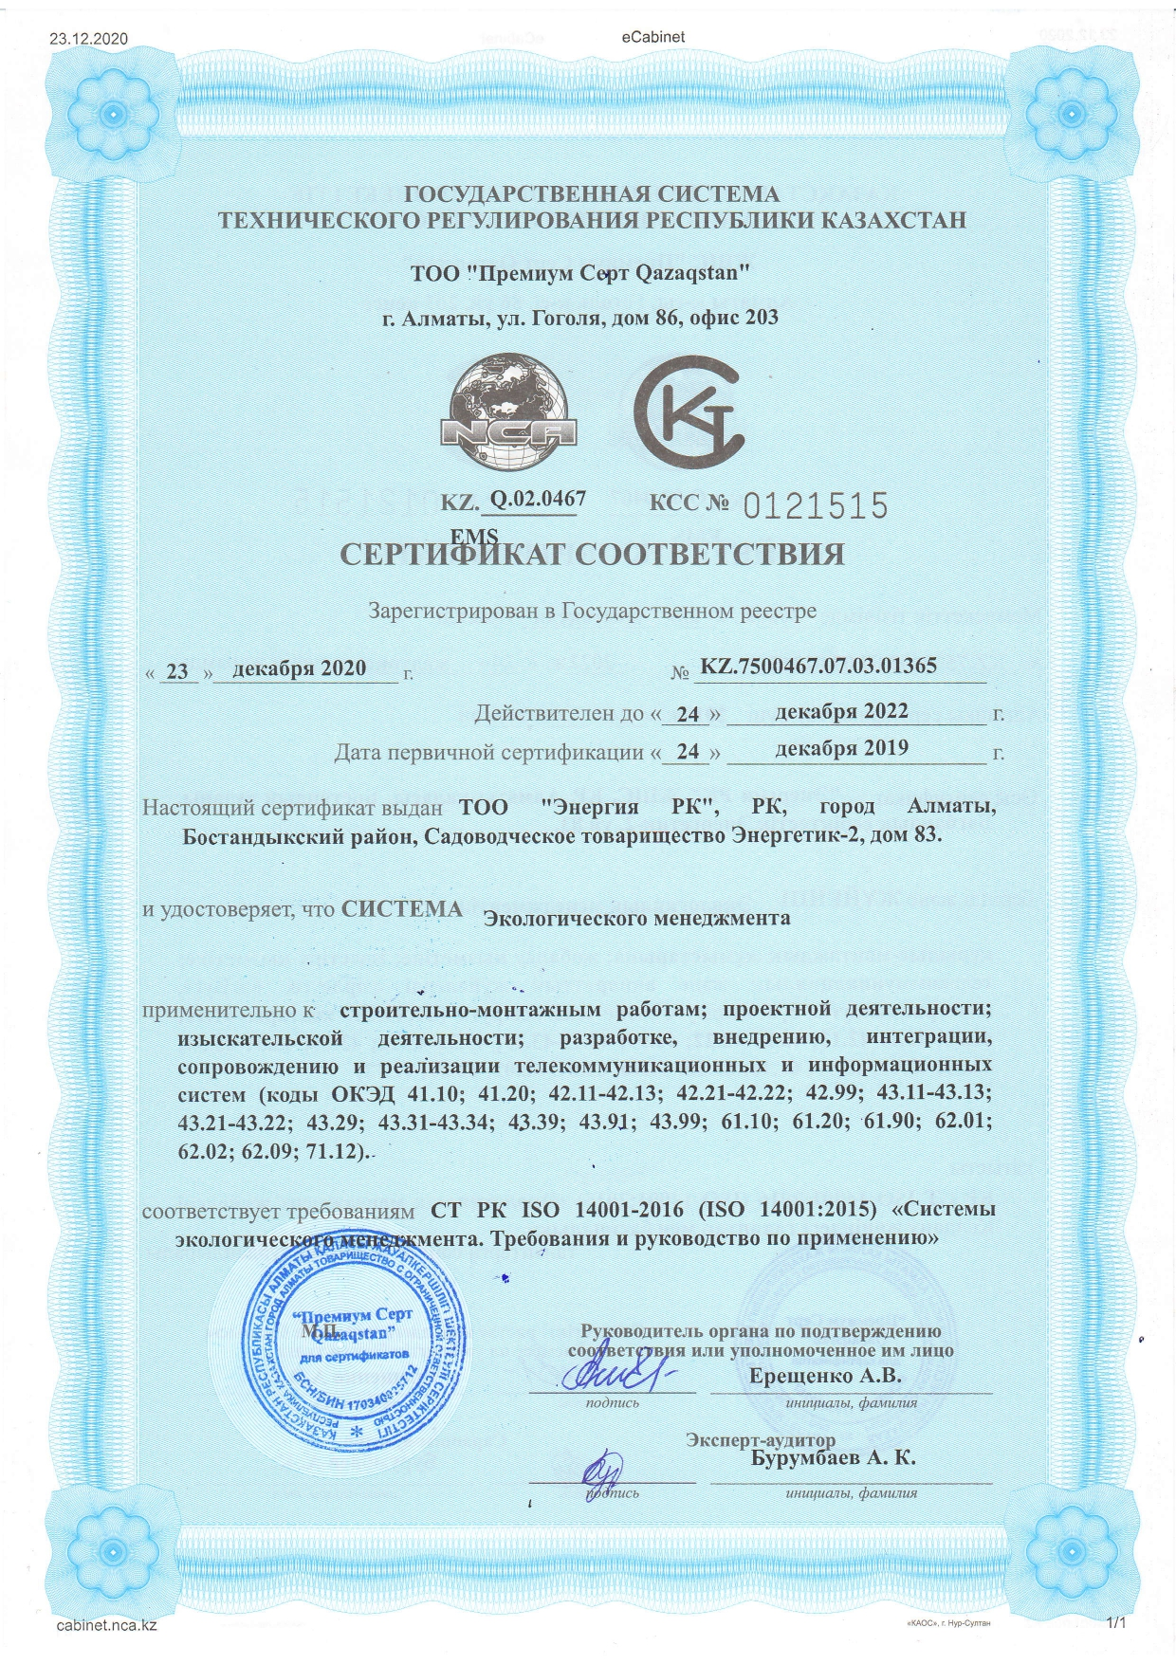
Our Management Certificates:
Quality Management System
Occupational Safety Management System and health protection
Environmental Management System

Slide 10
Energia RK in figures:
15
16
70
500
years of experience
foreign partners
industrial facilities
completed projects

Slide 11
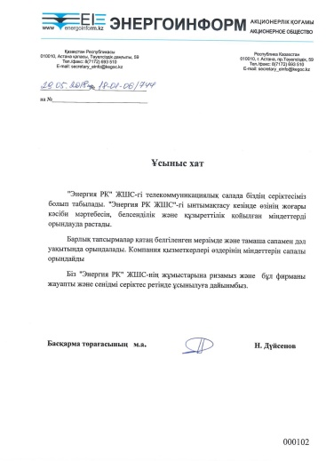
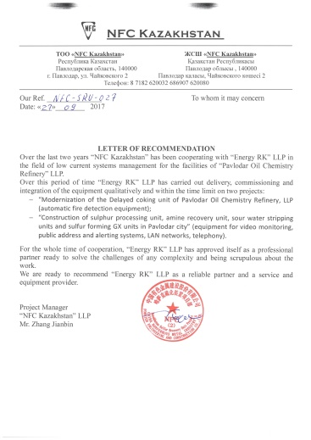
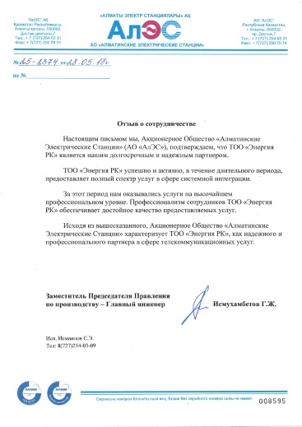
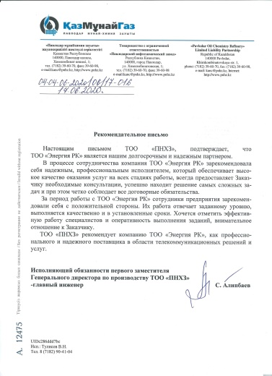
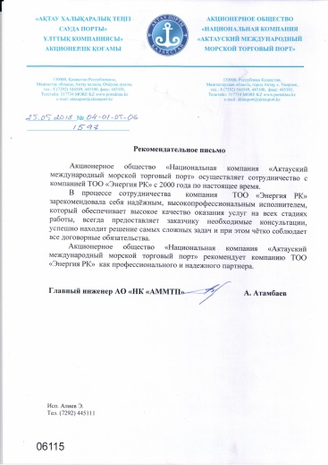
We are recommended:
and many others…

Slide 12
Our Mission:
“I, We are the unity of potentials of the best innovations of the Planet and Energy of living People, a team of professionals who are absolutely devoted to their Business, readily acting to obtain the result for the Client, in the implementation of unique needs and projects, development in the field of digital (IT) products, information and communication systems and networks for companies in industry, energy and transport.”

Slide 13
Our Values:
“Internal compass” for quick adoption of optimal decisions in the Company
I, Love:
We are convinced
that everything we do,
we do with LOVE to ourselves and to the World around us.
I, Action: We are convinced
that everything we do,
we do with readiness and dedication to our CASE.
.
I, Development: We are convinced
that everything we do,
we do to develop
our potential.
I, Common sense: We are REALISTS and we are convinced that the basis for making our decisions are: common sense, practical experience and analysis
of our own mistakes.

Slide 14
10
70
500
зарубежных партнеров
промышленных объектов
реализованных проектов
Our contacts:
Address:
Almaty, CO “Energetik-2”, building 83
Telephone:
+7 727 246 04 20 / +7 771 246 04 20
E-mail:
info@erk.kz
Website:
www.erk.kz
Instagram:
@energiark.kz

